Slide 1
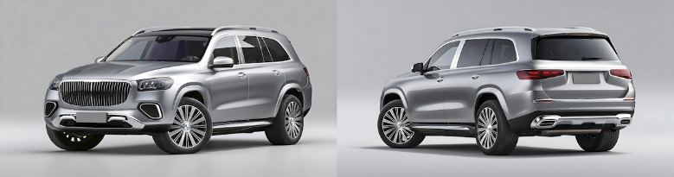
Exterior design evaluation – Mercedes GLS
TOTAL Sample
(n=203)
Subgroups
(Base: current car)
PHEV owners | BEV owners | Combustion engine + Hybrid
33 | 92 | 78
KEY TAKE-AWAYS
Design generates excitement for majority of customers, especially those who currently own a BEV
German customers are familiar with the design language of Mercedes even without brand reveal
8.1
7.6 | 8.4 | 8.0
Average
Score on 10-point scale
Ratings in detail
Rejection (rating 1-4) | 5%
Excitement (rating 9-10) | 51%
6% | 5% | 4%
33% | 63% | 45%
Source: HKM Survey, Base: n=203
Question D1 How would you evaluate the exterior design concept of this vehicle?

